Slide 1
Fitness and Sports Tracker Python based project
Let's explore how wearable technology is revolutionizing the way we track our health and fitness goals."
Team members
Name & university roll no:
Tanya 2330656
Sumit bisht 2330655
Upender 2330659

Slide 2
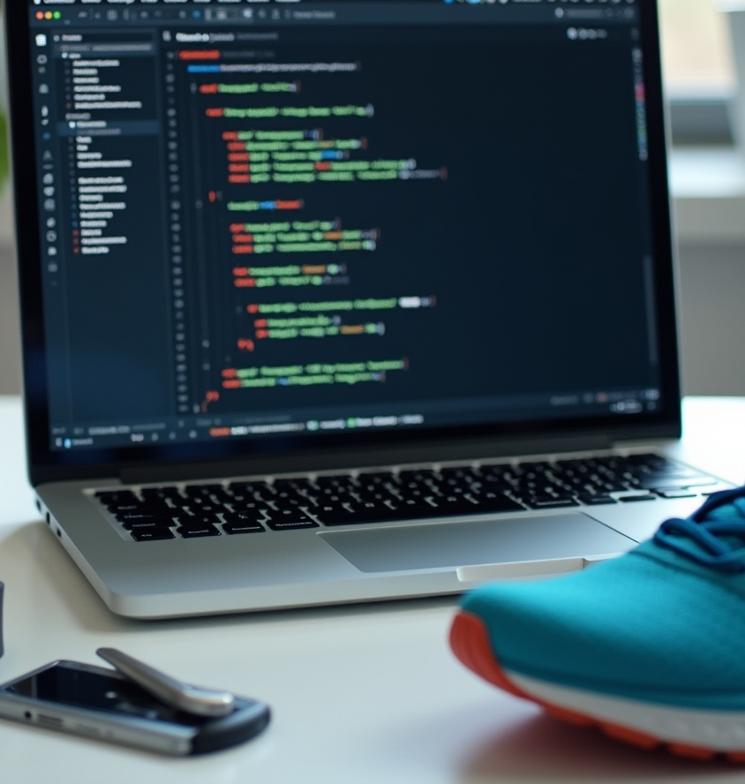
Introduction
"Welcome to our presentation on Fitness and Sports Trackers. Let's explore how wearable technology is revolutionizing the way we track our health and fitness goals Revolutionizing fitness with wearable technology: tracking progress, achieving goals, and empowering a healthier lifestyle through data-driven insights and personalized feedback.
This presentation outlines the development of a Fitness and Sports Tracker using Python. We will explore its objectives, core functionalities, and technical implementation to deliver a robust solution for athletes and fitness enthusiasts.

Slide 3
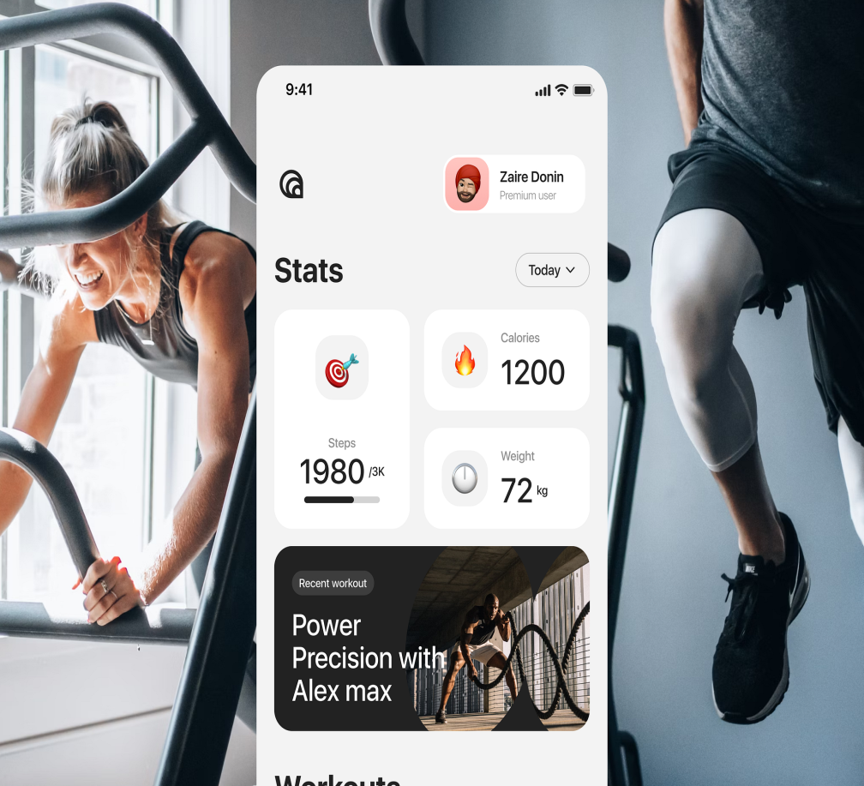
Project Overview This project explores the role of fitness trackers in promoting physical activity and improving health outcomes. It provides a comprehensive overview of fitness tracking technology, its applications, benefits, and limitations, and discusses potential future directions for innovation and research. This project examines the impact of wearable fitness trackers on individual health and wellness, highlighting their benefits, limitations, and potential applications in healthcare and sports, to inform future development and research.

Slide 4
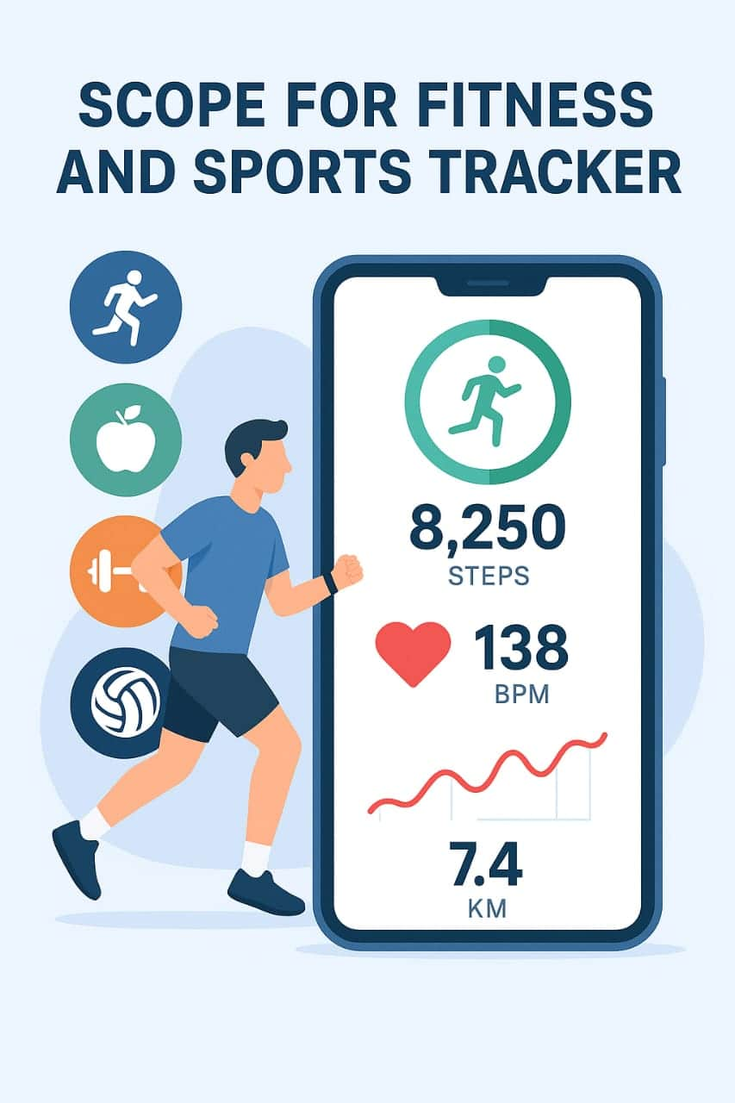
Objectives and Scope
The project aims to create a reliable sports and fitness tracking application that helps users monitor their physical activities. The scope includes tracking metrics like steps, heart rate, and calories burned. It targets users ranging from casual exercisers to serious athletes looking for performance insights.

Slide 5
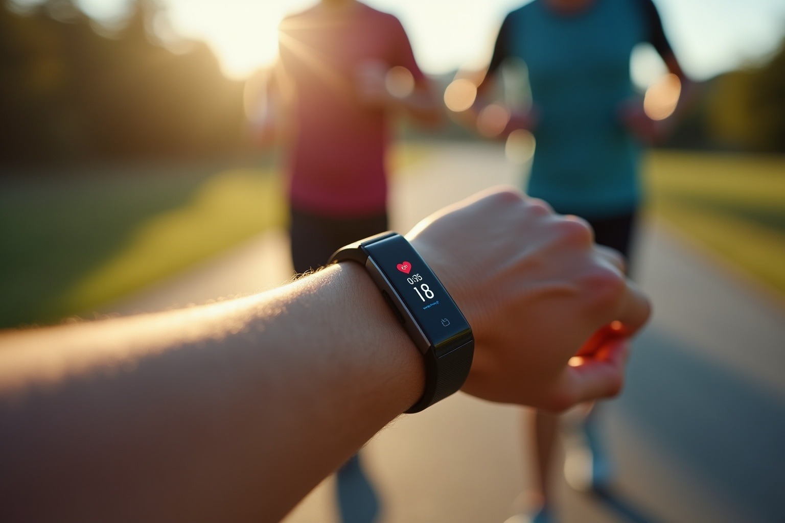
Key Features
Key features include real-time data collection from sensors, precise activity recognition, and detailed analytics. The tracker supports customizable workout settings, progress visualization, and motivational alerts.
Step Tracking: Monitoring daily activity and step count.
2. Distance Tracking: Measuring distance traveled during walks, runs, or other activities.
3. Calorie Burn Tracking: Estimating calories burned based on activity level.

Slide 6
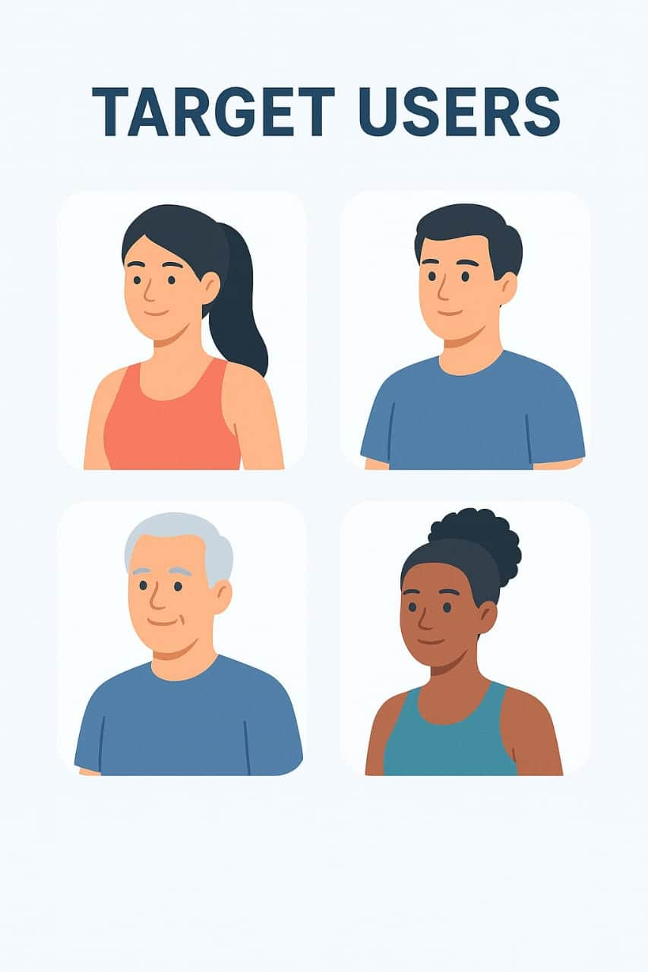
Target Users
The primary users of the fitness tracker range from casual fitness enthusiasts to professional athletes seeking detailed performance data. This tool is designed to accommodate varying fitness levels, offering insights that help optimize training routines. It also targets health-conscious individuals interested in monitoring daily activity and improving their wellness effectively.

Slide 7
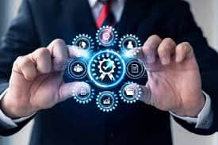
Technical Implementation 1. Sensors: - Accelerometer (motion tracking) - Gyroscope (orientation tracking) - Heart rate monitor - GPS (location tracking) 2. Microcontrollers: - Processing and storing data from sensors - Managing power consumption and battery life 3. Connectivity: - Bluetooth Low Energy (BLE) for syncing data with smart phones - Wi-Fi for data upload and cloud syncing 4. Data Analytics: - Algorithms for step tracking, distance calculation, and calorie burn estimation - Machine learning for activity recognition and personalized insights 5. Power Management: - Optimizing power consumption for long battery life - Power-saving modes for reduced activity tracking.

Slide 8
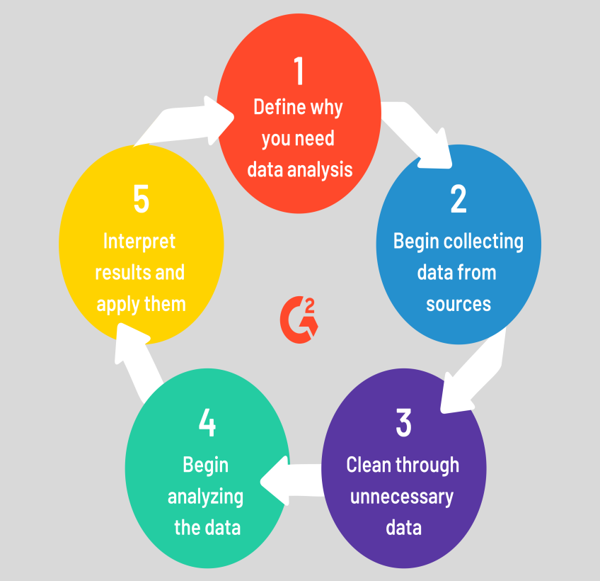
Data Processing and Analysis
Collected data is processed through Python algorithms to filter noise and extract meaningful statistics. Advanced techniques analyze performance trends, calorie expenditure, and activity patterns. This processing enables personalized feedback and actionable insights for the users.

Slide 9
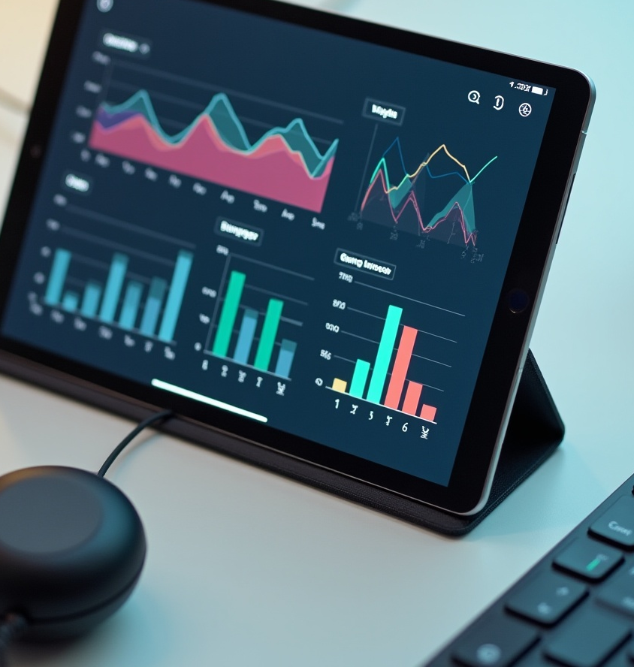
User Interface Design
The user interface is designed for intuitive navigation and quick access to vital statistics. Visual elements such as graphs and progress bars provide clear representations of fitness metrics. The design prioritizes responsiveness and accessibility to enhance overall user experience. The user interface of a fitness tracker is designed to be intuitive and user-friendly, providing easy access to key features and data. It typically includes a display screen showing metrics like steps, distance, heart rate, and calories burned, as well as navigation buttons or touch screens for seamless interaction.

Slide 10
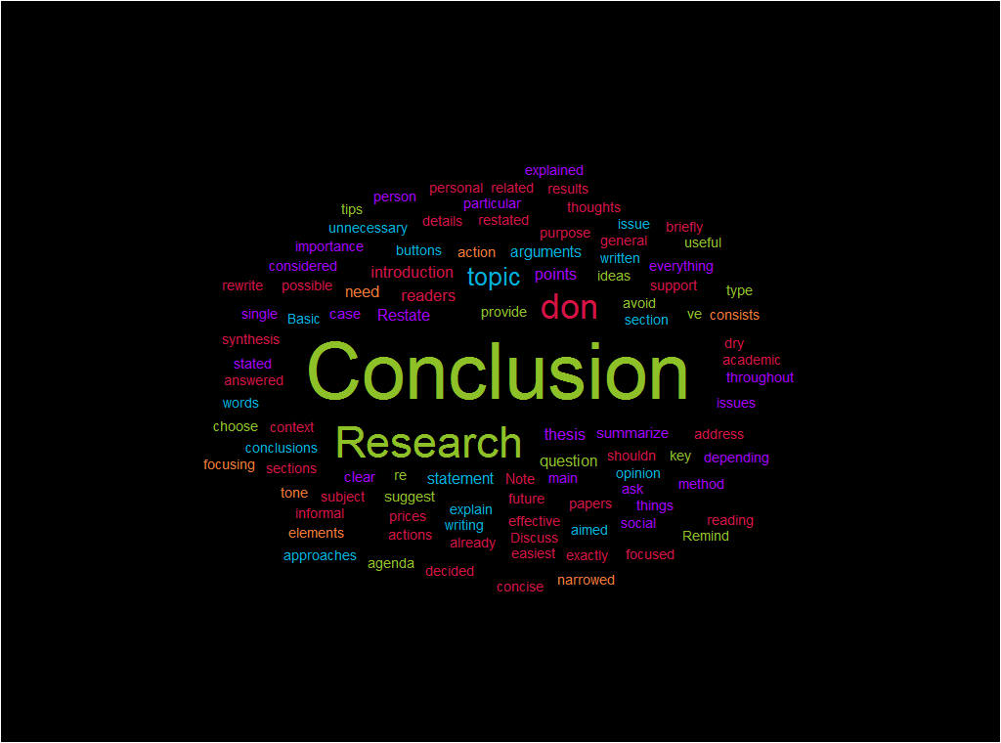
Conclusions
The fitness and sports tracker project delivers a comprehensive solution that combines accurate data collection, robust analysis, and an engaging user interface. It successfully meets diverse user needs by promoting informed training decisions and healthier lifestyles. Future enhancements may include expanded sensor support and AI-driven coaching features.

